Slide 1

IBM EMPLOYEE ATTRITION PREDICTION
DSC 424 Final Project Presentation
Serena Yang, Yueting Zhao

Slide 2
Introduction
Data
It is a Human Resources Problem!
Progress
Conclusion

Slide 3
Introduction
Introduction
The goal of this project:
Uncovered the factors that lead to IBM employee attrition
Predict if an employee is likely to quit
Data
Progress
Technique will use:
Backward Elimination & Forward Selection
Lasso
Principal Component Analysis
Linear Discriminant Analysis
Logistic Regression and receiver operating characteristic
Conclusion

Slide 4
What is our data?
Introduction
Data was published by the Human Resource department of IBM
Source Website: Kaggle
Data
Before Data Cleaning:
37 variables
23,436 rows
Progress
Conclusion

Slide 5
Data Background

Slide 6
What is our data?
Introduction
Redundant variables:
Daily Rate
Employee Count
Application ID
Over 18
Standard Hours
Data
Progress
Conclusion

Slide 7
Data Cleaning
Introduction
23 Variables:
11 categorical
12 numeric
Data
Progress
Omit NAs variables:
236 Objects
Conclusion

Slide 8
Separate Data
Introduction
Data
Training
Test
Progress
80%
20%
Conclusion

Slide 9
Progress

Slide 10
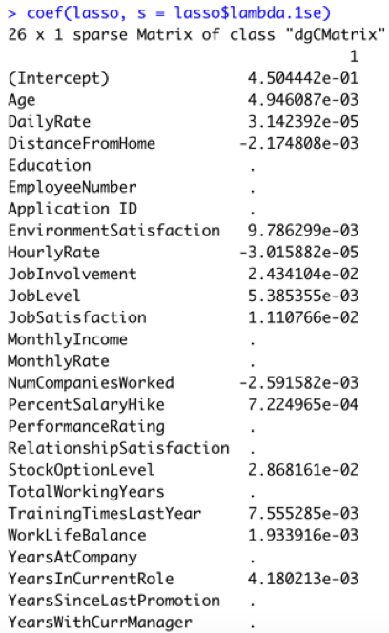
LASSO
Introduction
Lasso can perform feature selection.
lasso$lambda.1se = 0.007877239
Total number of variables is reduced to 14.
Data
Progress
Conclusion

Slide 11
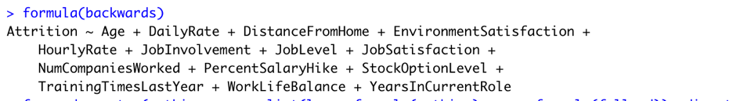
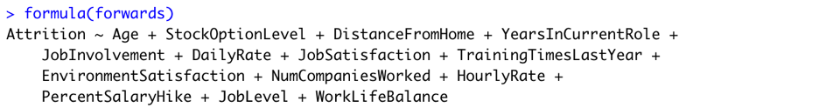
Stepwise Selection
Introduction
Data
Progress
Conclusion
The results from Stepwise Selection are supported the Lasso result

Slide 12
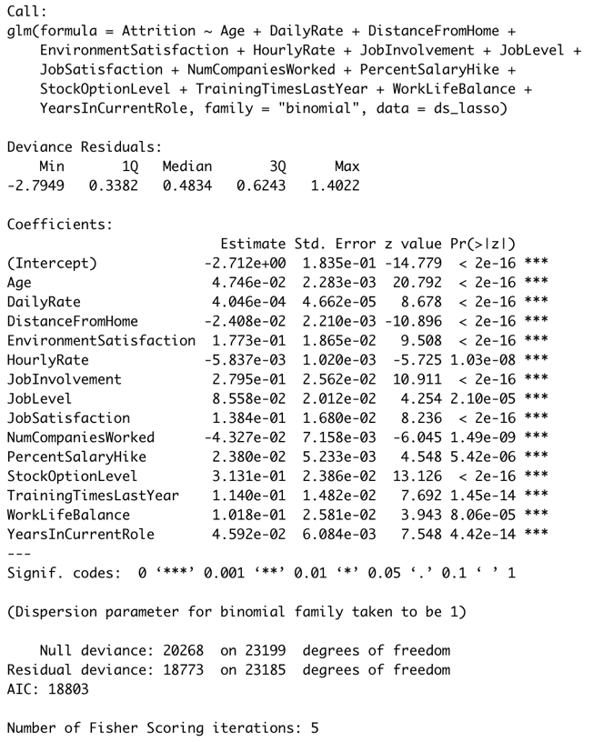
Logistic Regression
Introduction
The result of the logistic regression:
1.p-value.
2.Null deviance and Residual deviance
Data
Progress
Conclusion

Slide 13
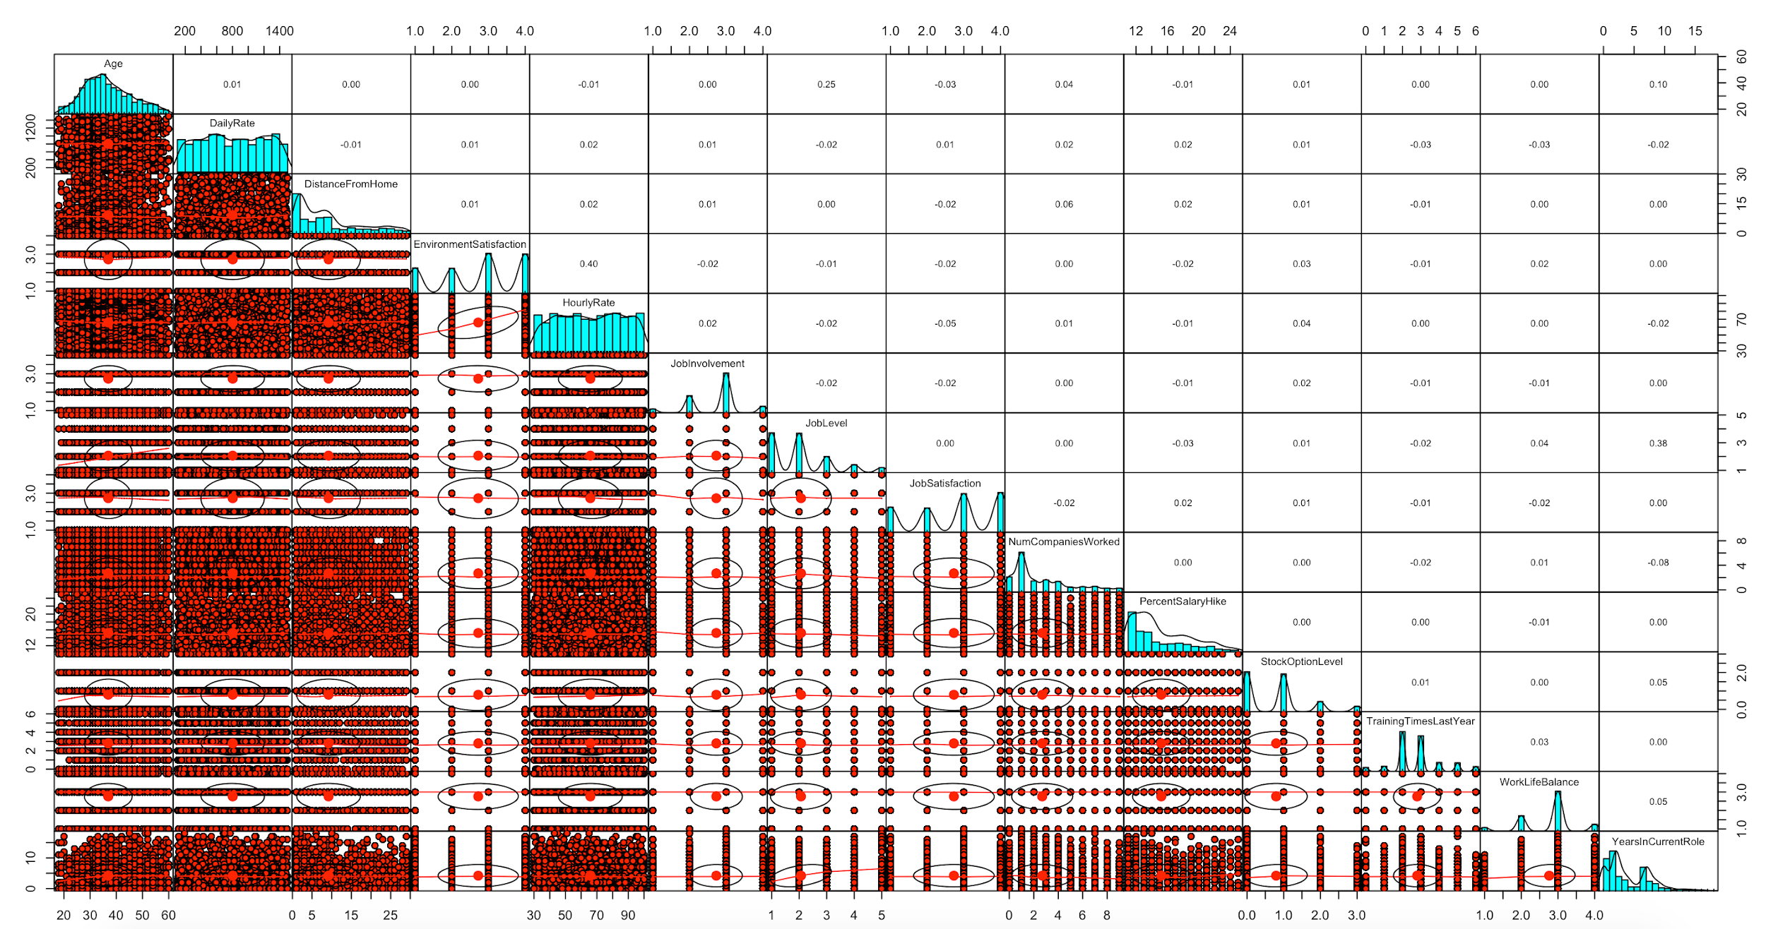
Scatter Plot and Correlations
Introduction
Data
Progress
Conclusion

Slide 14
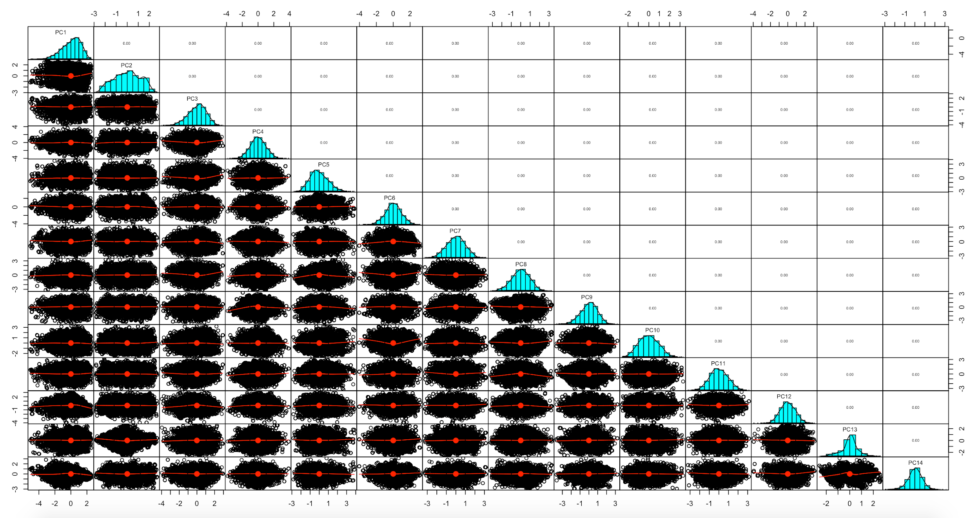
Scatter Plot and Correlations with PCA

Slide 15
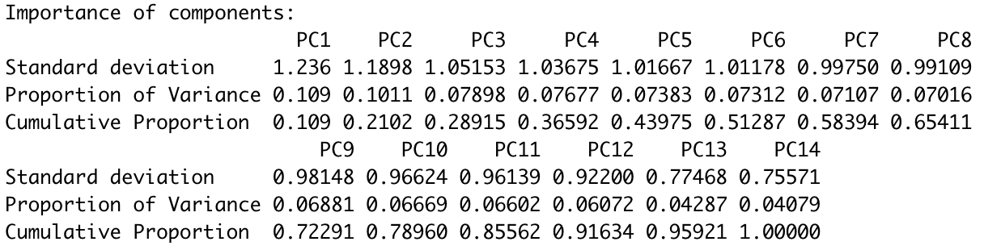
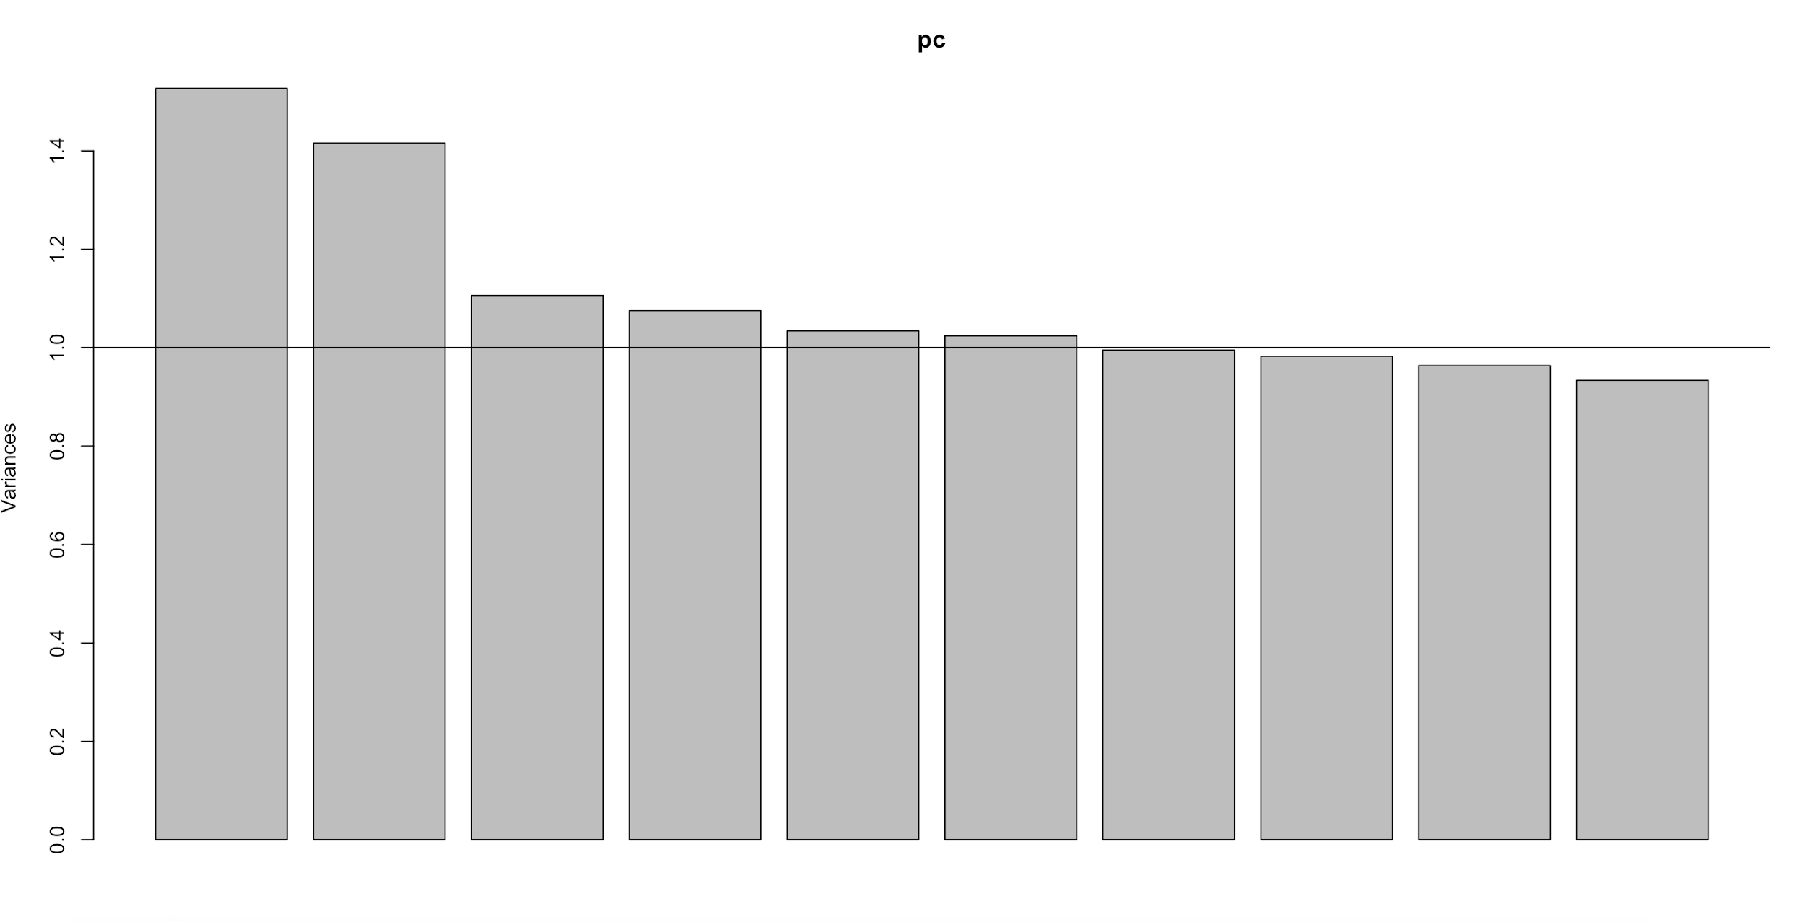
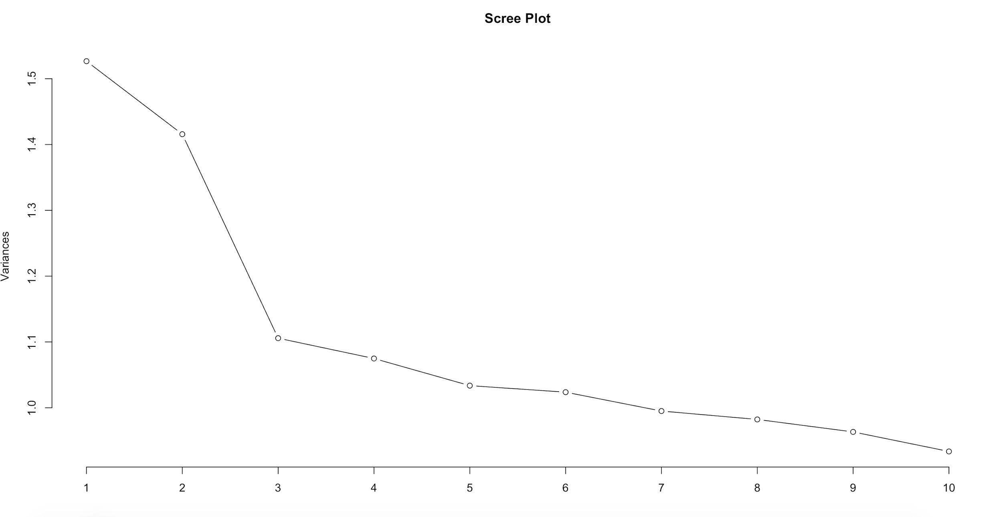
PCA - Summary
Introduction
Data
Progress
Conclusion

Slide 16
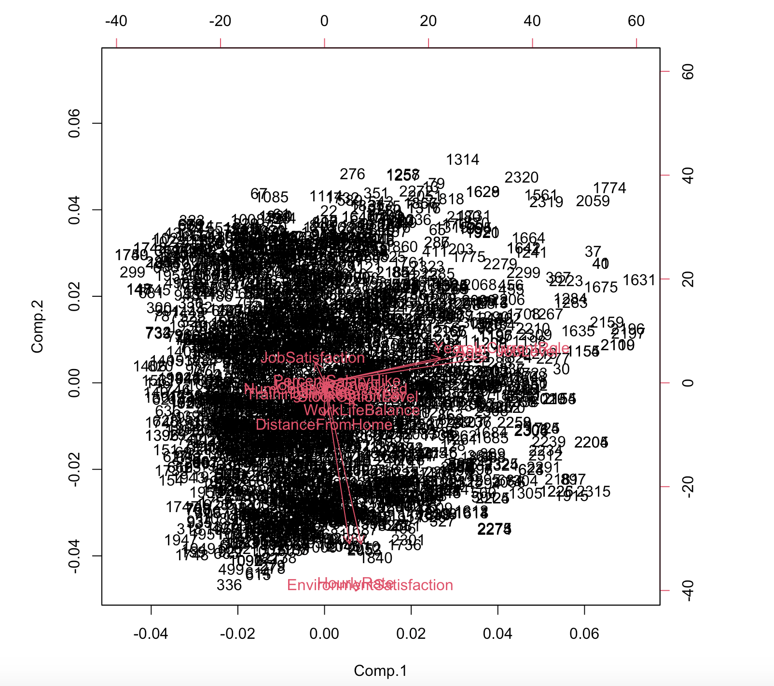
PCA - BiPlot
Introduction
Data
Progress
Conclusion

Slide 17
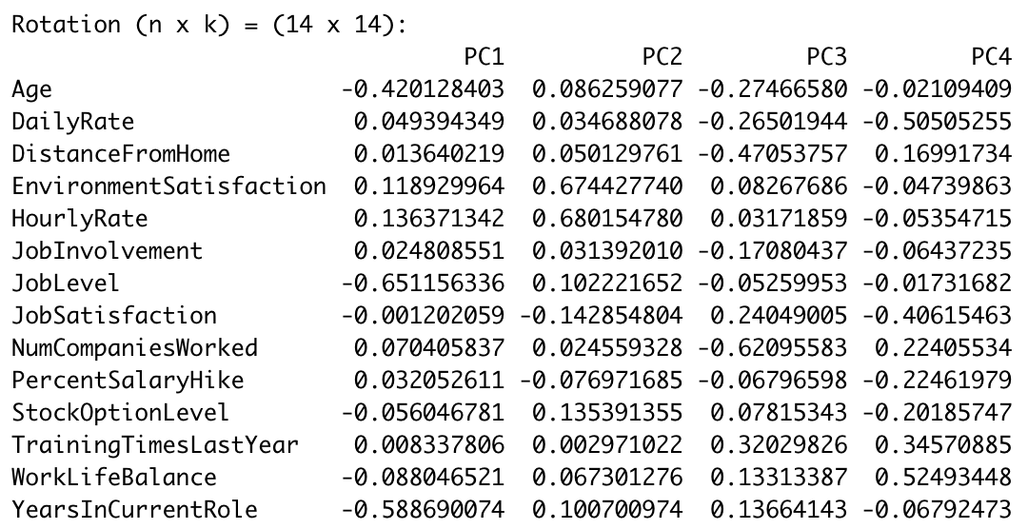
PCA - Loadings
Introduction
Data
Progress
Conclusion
Notes:
Employees who are at Employees who are at younger age, lower job level, and work less years in the current role show higher potential to leave.
Employees who value their environment satisfaction lower and have lower hourly rate contribute to Attrition more.
Employees who live further away from work and work less years in the company may choose to leave easier. Employees who value their environment satisfaction lower and have lower hourly rate contribute to Attrition more.
Employees who live further away from work and work less years in the company may choose to leave easily

Slide 18
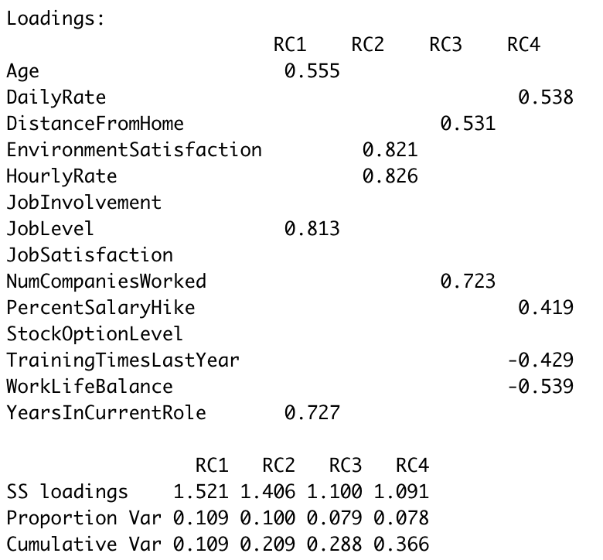
Factor Analysis and Loadings
Introduction
The best N factors:
Data
Progress
Conclusion

Slide 19
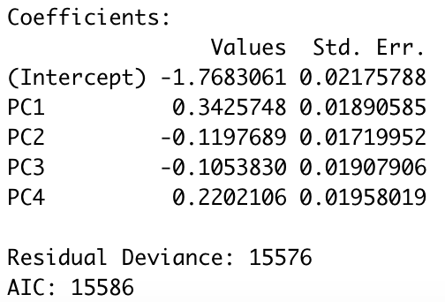
Fit Model with PCs
formula = Attrition ~ PC1 + PC2 + PC3 + PC4

Slide 20
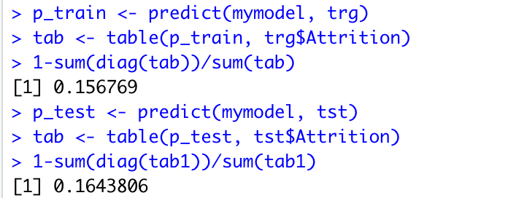
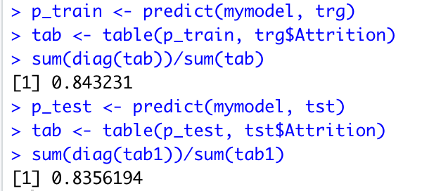
Prediction with Principal Components
Introduction
Misclassification:
Prediction Accuracy:
Data
Progress
Conclusion
Notes:
mymodel <- multinom(Attrition ~ PC1 + PC2 + PC3 + PC4, data = training)
formula = Attrition ~ PC1 + PC2 + PC3 + PC4
Predict:

Slide 21
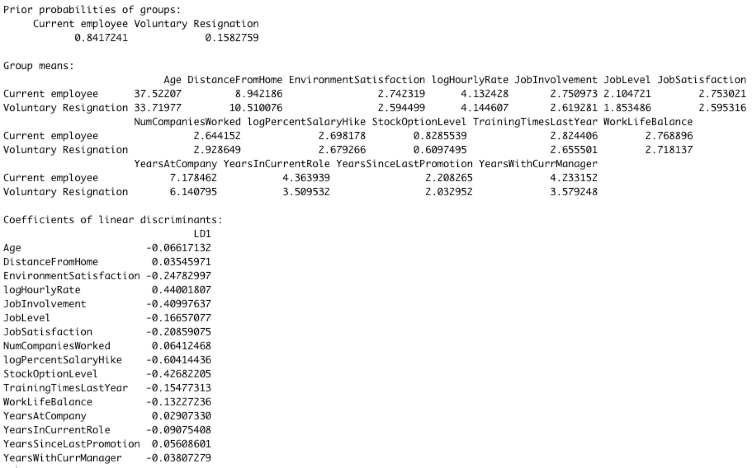
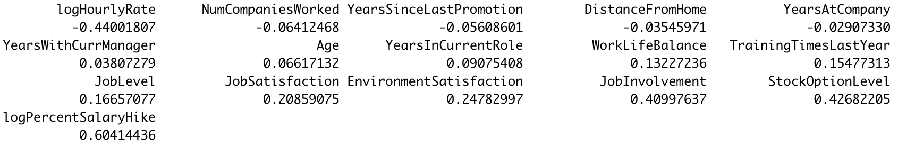
LDA
Introduction
Data
Progress
Conclusion
loadings

Slide 22
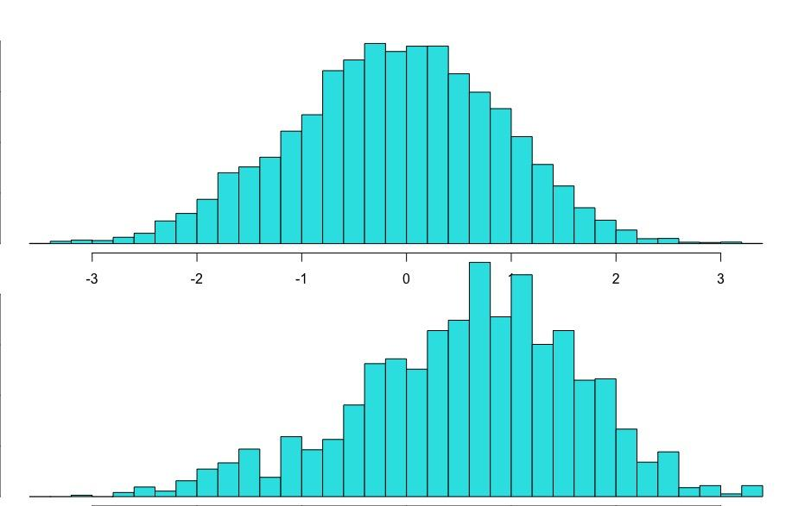
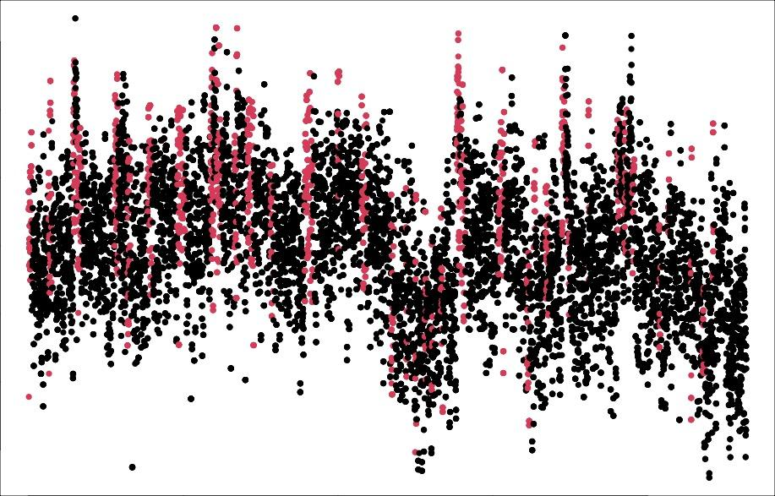
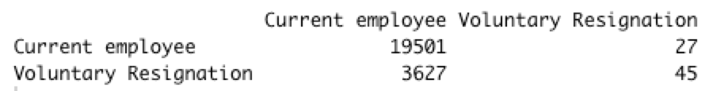
LDA
Introduction
Data
Progress
separation
classification
Conclusion
Confusion matrix

Slide 23

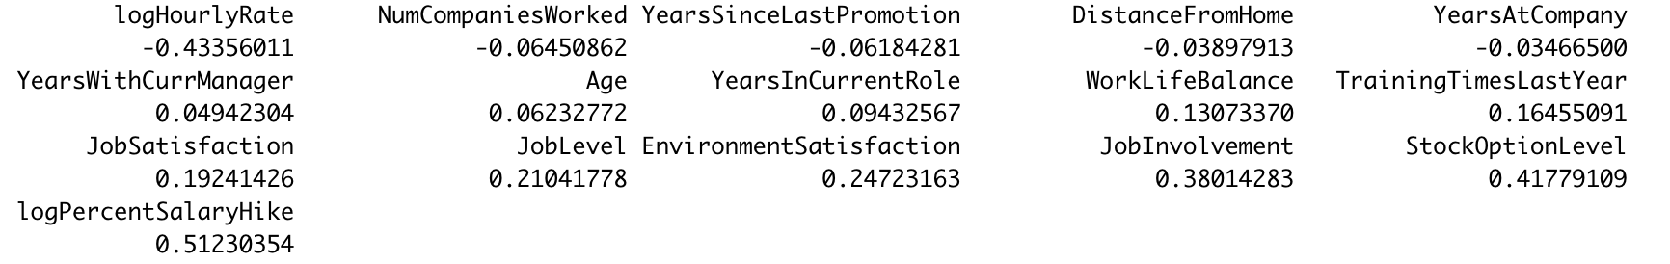
LDA
Introduction
Data
Progress
Conclusion
loadings

Slide 24
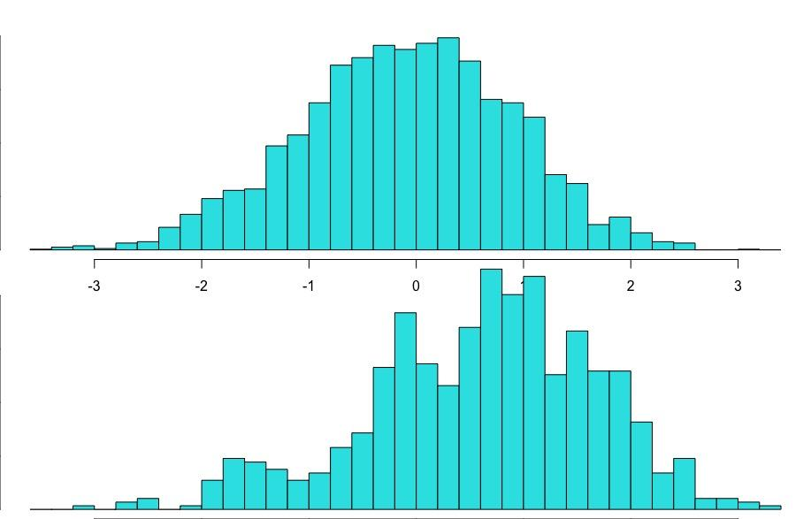
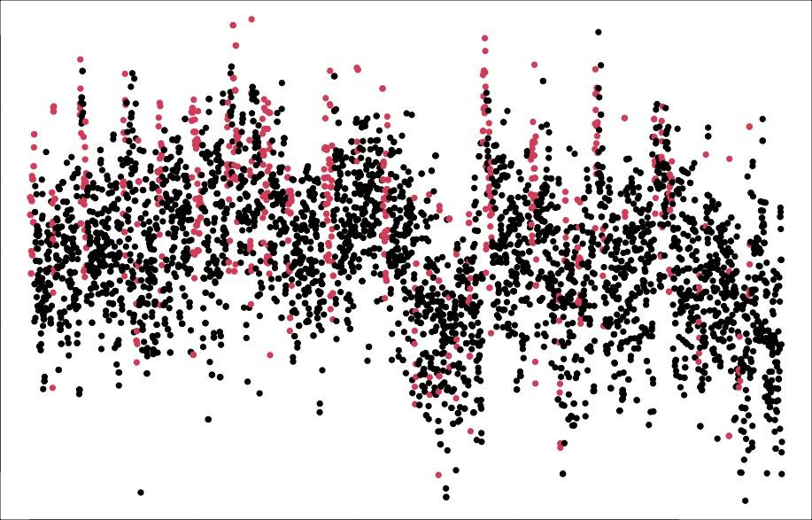
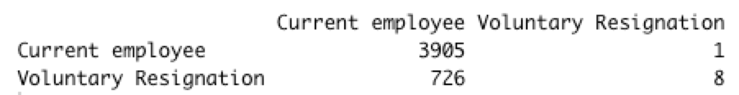
LDA
Introduction
Data
Progress
separation
classification
Conclusion
Confusion matrix

Slide 25
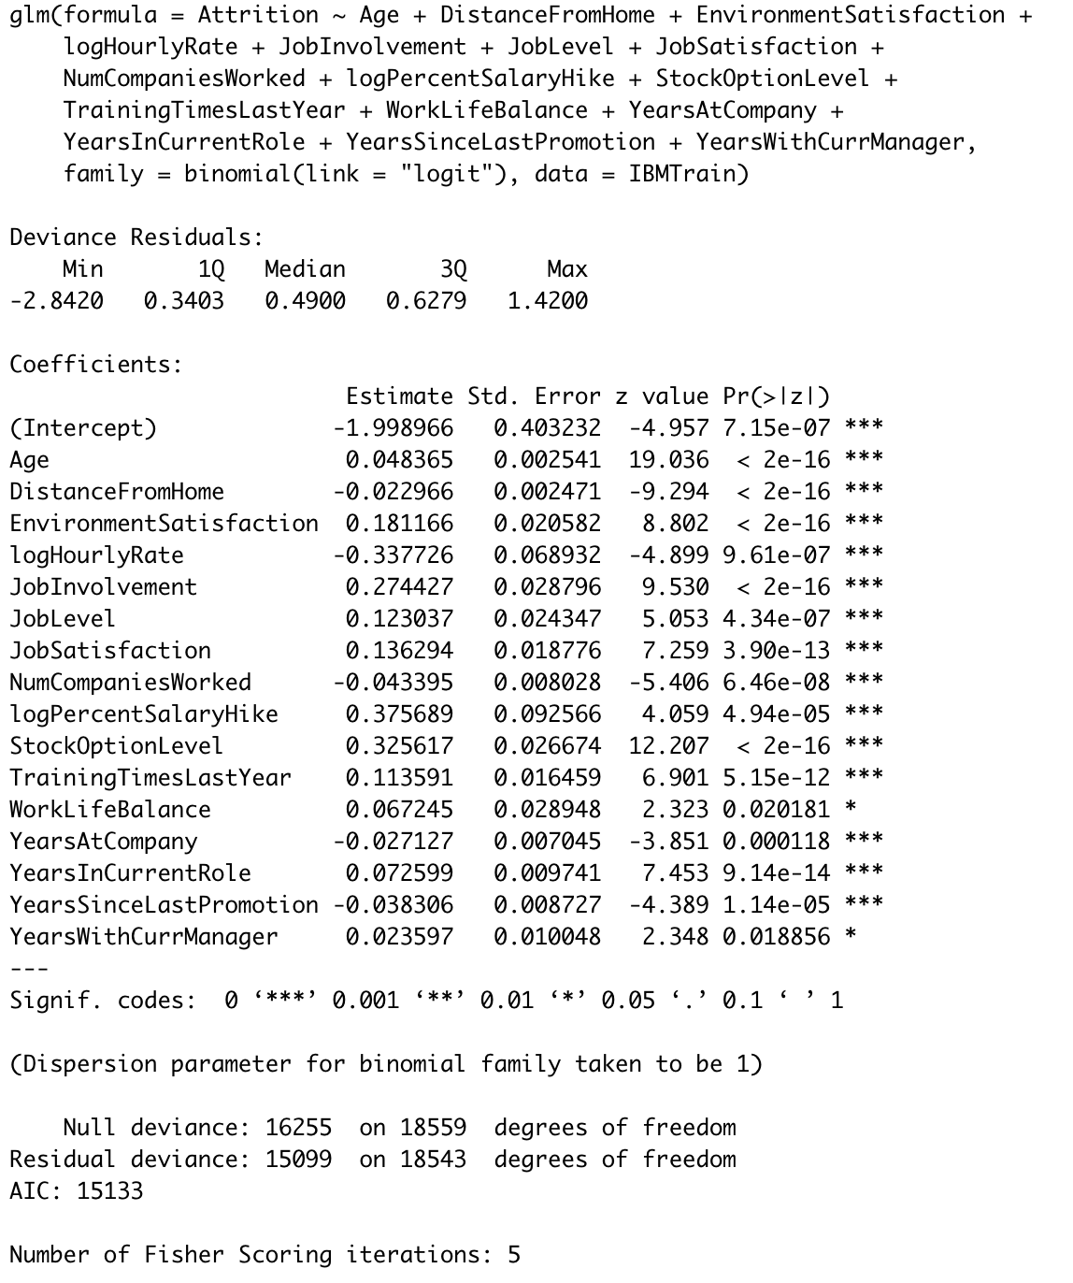
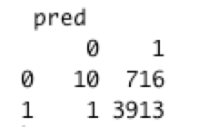
Logistic Regression
Introduction
Data
Progress
Conclusion

Slide 26

ROC curve
Introduction
Data
the area under the curve:
0.7083863
Progress
Conclusion

Slide 27
Conclusion

Slide 28
Conclusion
Introduction
Employees who are at younger age, lower job level, and work less years in the current role show higher potential to leave.
Employees who value their environment satisfaction lower and have lower hourly rate contribute to Attrition more.
Employees who live further away from work and work less years in the company may choose to leave easily.
The variables of Job Involvement, Stock option level, percent salary hike, Hourly Rate strongly contributes to the target variable Attrition.
Data
Progress
Conclusion

Slide 29
Thank you for watching!
Introduction
Data
Progress
Conclusion

